Slide 1
CIS095-1 DATABASES AND COMPUTER NETWORKS
CIS017-1 Computer Systems Structure
Lecture 3: Database Design (Database Normalisation)
Dr. Mahmoud Artemi

Slide 2
Previous lecture we learnt
Data Modelling
  Entity Relationship Modelling (ERM) (Database Conceptual and Logical Design)
ER Representation - ER Diagram
  Chen’s notation
  Crow’s Foot notation
Relational Data Model (RDM - table)
Boyce-Codd data model (Database physical design)

Slide 3
Database Desing in a Data System Development
Requirements collection and analysis (system & data)
Develop Conceptual Data Model (ERM)
Develop Logical Data Model
Database Design (RDM)
Table Definitions
Physical Design
Build Database
Notes:
A conceptual data model creates relationships between information sources, users, and business process steps.
The conceptual data model is used to develop a logical data model based on one of the primary DBMS types: relational, hierarchical, network, or object-oriented approaches.
With the logical data model in hand, developers move to the physical design, which involves determining the specific storage and access methods and structures.

Slide 4
Relational data model (RDM)
A relational data model (in RDBMS) represents data in a table.
  Rows in a table represent a collection of related data (object, record). These rows in the table denote a real-world entity
  Columns in a table represent selected attributes for the data object. They are properties of a real-word entity
  The table name and column names are helpful to interpret the meaning of values in each row (record).

Slide 5
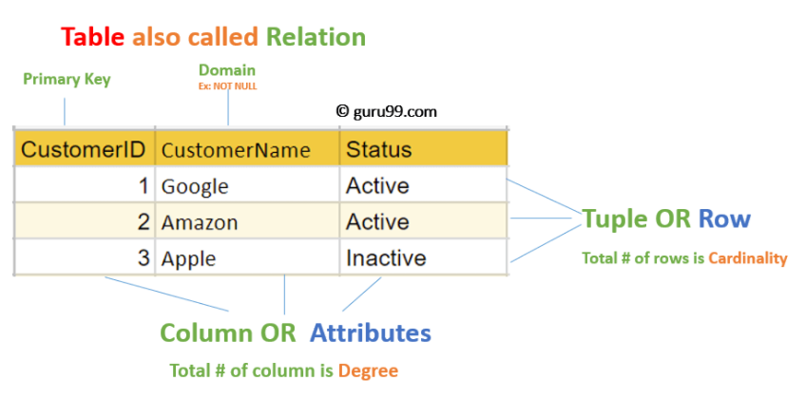
Relational Data Model (in Table)

Slide 6
Constraints in RDM (individual table)
Every relation has some conditions that must hold for it to be a valid relation. These conditions are Relational Integrity Constraints.
  Key constraints (Primary key has to be unique)
  Domain constraints (Each column has a domain (or data type) which defines the allowed values in the column.)
Some other constraints are ….
  No duplicated rows
  No necessary order to the rows (top to bottom)
  Columns have unique names within the same table.
  No necessary order to the columns (left to right)
  All rows in a table have the same set of columns.

Slide 7
Problems
RDM defines individual table NOT multiple tables
Any data system is hardly just one table
Multiple tables will have a referral and consistency issue
The problem is how to make multiple tables work together for a data system?

Slide 8
To ensure these Constraints cross multiple tables is through
    Table Normalisation
That is what a database design mean

Slide 9
Outline
What is Database design?
Concepts of Functional Dependencies
Normalization
  Redundancy & Anomalies
  Normal forms
  Process of normalization

Slide 10
Database Design
What is ?

Slide 11
What is Database Design?
Database Design is a step in the process of facilitate the designing, development, implementation and maintenance of a data (management) system.
The goal of databased design is easy to maintain stored data (in multiple tables), improve data consistency and provide a cost effective data usage.
The main jobs of database design are to produce logical and physical models of the proposed database system.

Slide 12
Logical and physical design models
ERM (conceptual model)
The logical model concentrates on the data requirements and the abstract (over) view of data to be stored. It is independent of physical considerations like how the data will be stored or where it will be stored physically.
The physical data design model involves translating the logical design of the database onto physical media using hardware resources and software systems such as database management systems (DBMS).

Slide 13
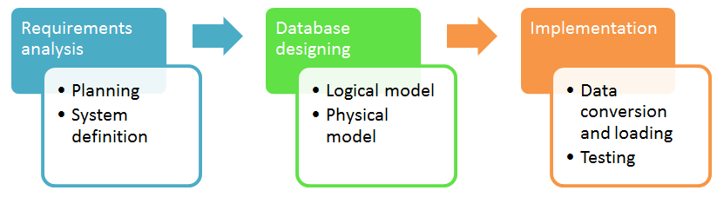
Database development life cycle
Requirements analysis
Database design
Implementation
The steps in the development life cycle do not necessarily have to be followed religiously in a sequential manner.
On small database systems, the process of database design is usually very simple and does not involve a lot of steps.

Slide 14
Two most used Database Design Techniques
Entity Relationship Model (ER Modelling- Conceptual design) is a graphical approach to database design. It is a high-level data model that defines data elements and their relationship. An ER model is used to represent real-world objects (and relations).
Normalization (logical design) is a database design technique for determining which fields belong in which tables in a relational database. So it can reduces data redundancy and eliminates undesirable characteristics like Insertion, Update and Deletion Anomalies.

Slide 15
Normalization
https://www.cseworldonline.com/dbms-tutorial/normalization-in-dbms.php

Slide 16
What Is Normalization?
Normalization process, as first proposed by EF Codd (1970), takes a relation data model (RDM) through a series of tests to certify whether it satisfies a certain normal form.
The process proceeds in a top-down fashion by evaluating each relation (table) against the criteria for normal forms and decomposing relations as necessary, can thus be considered as relational design.
The purposes of Normalization is
  to minimize the redundancy from a relation or a set of relations.
  to eliminate the undesirable characteristics like Insertion, Update and Deletion Anomalies.

Slide 17
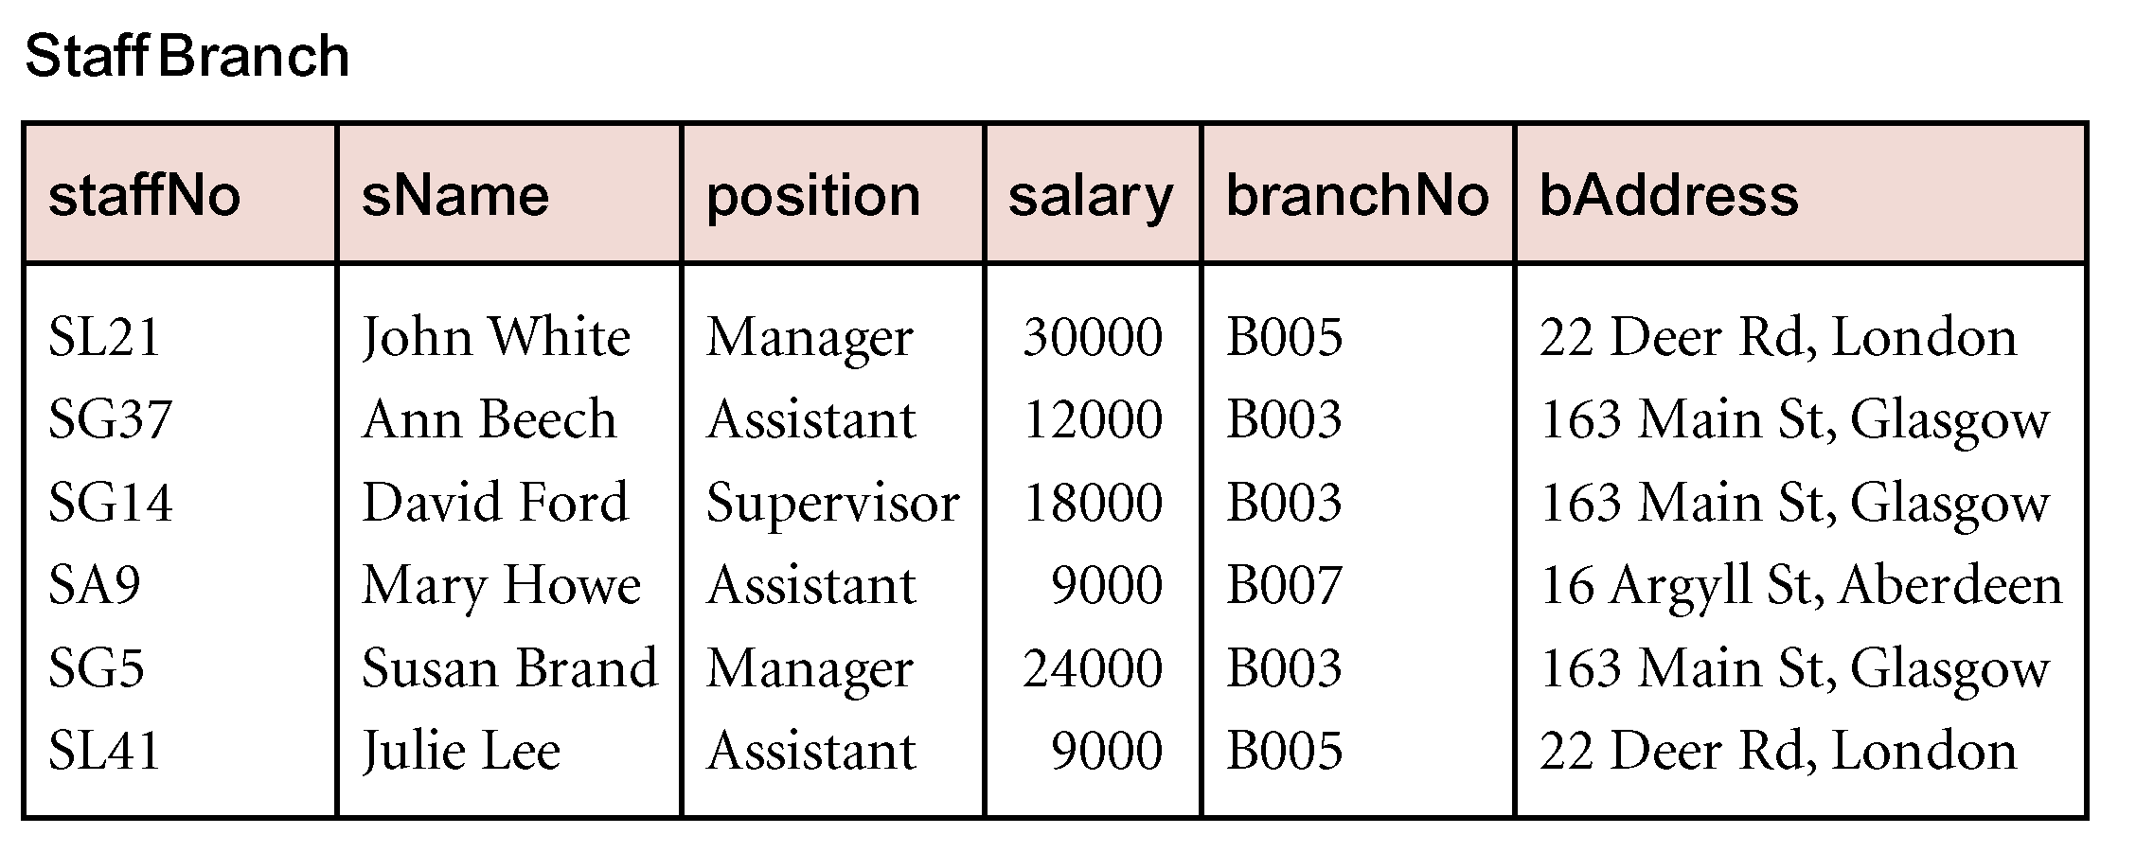
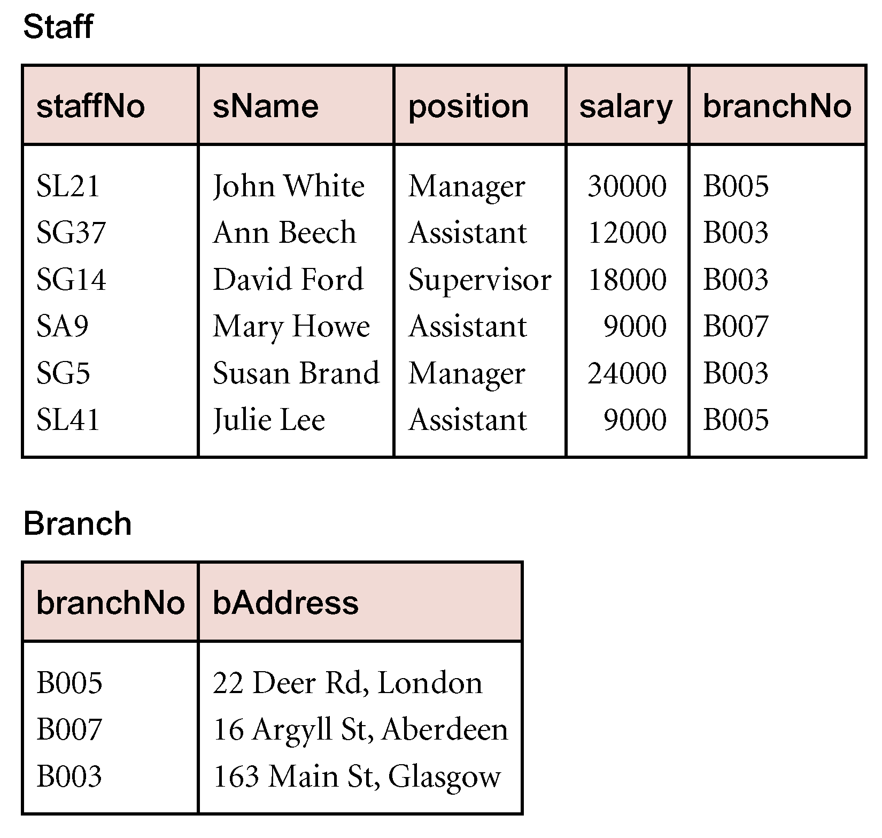
Redundancy
StaffBranch: details repeated for every member of staff located in the same branch
Staff: Only the Branch number is repeated providing foreign key to Branch
Branch: Details only listed once
Notes:
“Staff” and “Branch” are the “StaffBranch” table after normalisation

Slide 18
Anomalies
Anomalies occured due to some operations on the tables
  Update Anomalies
  Delete Anomalies
  Insert Anomalies

Slide 19
Update Anomaly
StudentNum | CourseNum | StudentName | Address | Course
S21 | 9201 | Jones | Edinburgh | Accounts
S21 | 9267 | Jones | Edinburgh | Physics
S24 | 9267 | Smith | Glasgow | Physics
S30 | 9201 | Richards | Manchester | Accounts
S30 | 9322 | Richards | Manchester | Maths
An Update Anomaly occurs when one or more instances of duplicated data is updated, but not all. (Partial update)
For example, consider Jones moving address - you need to update all instances of Jones's address.

Slide 20
Delete Anomaly
StudentNum | CourseNum | StudentName | Address | Course
S21 | 9201 | Jones | Edinburgh | Accounts
S21 | 9267 | Jones | Edinburgh | Physics
S24 | 9267 | Smith | Glasgow | Physics
S30 | 9201 | Richards | Manchester | Accounts
S30 | 9322 | Richards | Manchester | Maths
A Delete Anomaly occurs when certain attributes are lost because of the deletion of other attributes. Or partial deletion, it means we tried to delete a record, but parts of it was left undeleted.
For example, consider what happens if Student S30 is the last student to leave the course (Maths) - all information about the course (Maths) is lost. So we may leave StudentNum and delete all other values.

Slide 21
Insert Anomaly
StudentNum | CourseNum | StudentName | Address | Course
S21 | 9201 | Jones | Edinburgh | Accounts
S21 | 9267 | Jones | Edinburgh | Physics
S24 | 9267 | Smith | Glasgow | Physics
S30 | 9201 | Richards | Manchester | Accounts
S30 | 9322 | Richards | Manchester | Maths
An Insert Anomaly occurs when certain attributes cannot be inserted into the database without the presence of other attributes.
For example, this is the converse of delete anomaly - we can't add a new
course unless we have at least one student enrolled on the course. Or we insert data in a record that does not exist at all.

Slide 22
How?
Normalisation takes a relation data model (RDM) through a series of tests to certify whether it satisfies a certain normal form.
What are the different normal forms?

Slide 23
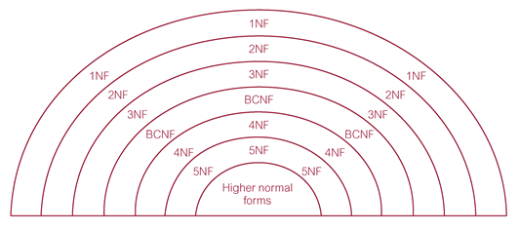
Types of Normal Forms
Each form has specific conditions.
The higher of the normal form level the better Database states.
Practically, not necessary the efficient of data Access.

Slide 24
Different Normal Forms

Slide 25
Unnormalized form (UNF)
Is also called An unnormalized relation or non first normal form (N1NF).
It has the following characteristics:
It only has a primary key.
It does not meet any of the conditions of database normalization defined by the relational model.
(Database systems which support unnormalized data are sometimes called non-relational or NoSQL databases. )

Slide 26
Another Example
table ORDERITEMS
2301 6/23 101 Volleyrite IL 3786 net 3 35
4011 racket 6 65
9132 3-pack 8 4
2302 6/25 107 Herman’s WI 5794 6-pack 4 5
2303 6/26 110 WR Sports MI 4011 racket 2 65
3141 cover 2 10
It contains a repeating group of ITEM NUM, ITEM DESCRIPTION, QUANTITY, and PRICE
First Normal Form (1NF) prohibits repeating groups.

Slide 27
First Normal Form (1NF)
A relation will be 1NF if it contains an atomic value.
Each record must be unique.
It states that an attribute of a table cannot hold multiple values. It must hold only single-valued attribute.
Each entry must have only one single value for each cell and each record must be unique.
Student ID | Student Name | Course
1 | Alice | Math
1 | Alice | Physics
2 | Bob | Chemistry
2 | Bob | Biology
2 | Bob | Mathematics
3 | Carol | Physics
Student ID | Student Name | Courses
1 | Alice | Math, Physics
2 | Bob | Chemistry, Biology, Mathematics
3 | Carol | Physics

Slide 28
Second Normal Form (2NF)
In the 2NF, relational must be in 1NF.
In the second normal form, all non-prime attributes are fully functional dependent on the primary key. NOT partially dependent on the primary key)
No partial dependency.
Student_Courses
Course_ID | Course_Name | Instructor | Instructor_Office
001 | Math 101 | Prof. Smith | Office A
002 | History 101 | Prof. Johnson | Office B
003 | English 101 | Prof. Adams | Office C
Student_ID | Course_ID | Course_Name | Instructor | Instructor_Office
101 | 001 | Math 101 | Prof. Smith | Office A
101 | 002 | History 101 | Prof. Johnson | Office B
102 | 001 | Math 101 | Prof. Smith | Office A
103 | 003 | English 101 | Prof. Adams | Office C
Student_ID | Course_ID
101 | 001
101 | 002
102 | 001
103 | 003

Slide 29
Third Normal Form (3NF)
A relation must be in 2NF and No transitive dependency for no-key attributes,
3NF has to reduce the data duplication.
No transitive dependency
MP_ID | EMP_NAME | EMP_ZIP
222 | Harry | 201010
333 | Stephan | 02228
444 | Lan | 60007
555 | Katharine | 06389
666 | John | 462007
Example: EMPLOYEE_DETAIL table:
P_ID | EMP_NAME | EMP_ZIP | EMP_STATE | EMP_CITY
222 | Harry | 201010 | UP | Noida
333 | Stephan | 02228 | US | Boston
444 | Lan | 60007 | US | Chicago
555 | Katharine | 06389 | UK | Norwich
666 | John | 462007 | MP | Bhopal
P_ZIP | EMP_STATE | EMP_CITY
201010 | UP | Noida
02228 | US | Boston
60007 | US | Chicago
06389 | UK | Norwich
462007 | MP | Bhopal

Slide 30
The key points
The higher of the normal form level the better Database states.
  Consistency
  Integrity
But …
Practically, not necessary the efficient of data Access.
So, it is worth noting that normal forms beyond 3NF are mainly of academic interest, as the problems they exist to solve rarely appear in practice.

Slide 31
The key points
Analysing relation data model based on their keys and on the functional dependencies among their attributes.

Slide 32
Functional Dependencies
Defines relationship between attributes

Slide 33
Foundations Dependency
Functional dependency provides a theoretical foundation for Normalisation to bring database to a NORMAL states
Functional Dependency
Functional dependency (FD) is a set of constraints between two attributes in a relation.
In DBMS, FD defines a relationship between attributes of a table.
It helps in preventing data redundancy and gets to know about bad designs.

Slide 34
Functional Dependencies
For any relation R, if every valid instance of A, that value of A uniquely determines the value of B, we say that attribute B is functionally dependent on (FD) attribute A. it is indicated by the representation below :
A → B
In this relationship,
  A, the left side of the above FD expression is called the determinant (primary key, PK), and,
  B, the right side is the dependent (no-key attribute or non-prime attribute).
Therefore, FD defines the dependence between A, the primary key (PK) and other attributes, no-key attribute, B.

Slide 35
Examples
In a customer relation (table), we have CustId, CustName, DoB, and Address and Tel.
Functional dependency:
CustId is functionally defines CustName or, CustName is functionally dependent on CustId.
CustId is determinant and Primary Key
CustName is dependent attribute and non-prime attribute
What about other relations? Such as DOB, Address and Tel?
CustId | CustName | DoB | Address | Tel
c001 | John | 24031984 | Brookland | 13256732105
c002 | Mary | 08071989 | Newlinedrive | 13234872923
CustId → CustName

Slide 36
Uniquely determines
Uniquely determines means that:
If two tuples have same values for attributes A (a1, a2, ..., an), then those two tuples also have the same values for attributes B (b1, b2, ..., bm).
Then we say A Uniquely determines B.
(NOT reverse … Different A NOT necessarily results different B, It means allows different A can have the same B)

Slide 37
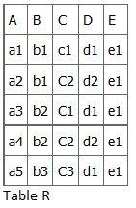


Example
In relation R, we can have:
A → B, A → C, A → D, A → E
Because A’s value are unique (a1, a2, a3, a4 and a5),
we can also have,
A → BC (or any other subset of ABCDE).
A is a primary key.
Consider B → C? (Same B must have same C) b1 has c1 and c2 so it does not hold.
Consider C → D? (Same C must have same D) c1 has d1 and c3 has d1 too. It is still unique! So C → D hold.
Cn
Cm
Ck
Dk
Two students (id) have the same name
Dm
Dn
One student (id) has two different names (persons)

Slide 38
Examples
For the given (film-cinema) relation identify the dependency relations
Fno
Name
Cno
Cname
Location
Mgno
Mname
Takings
23
Alfie
AB
Roxy
Oxford
01
Jones
200,000
23
Alfie
CH
Odeon
Telford
01
Jones
250,000
23
Alfie
MZ
Roxy
Bristol
03
Smith
350,000
31
Sin City
AB
Roxy
Oxford
01
Jones
200,000
31
Sin City
CH
Odeon
Telford
01
Jones
350,000
31
Sin City
MZ
Roxy
Bristol
03
Smith
150,000
31
Sin City
BA
Odeon
Bristol
04
Davies
400,000
76
Batman Begins
AB
Roxy
Oxford
01
Jones
200,500
76
Batman Begins
BA
Odeon
Bristol
04
Davies
355,000

Slide 39
A systematic way to determine dependency
Thumb Rule
Is determinant
Duplicate?
Yes
No
Is Dependent
Duplicate?
Member of FD
No
Yes
Not
Member of FD

Slide 40
Example
Fno
Name
Cno
Cname
Location
Mgno
Mname
Takings
23
Alfie
AB
Roxy
Oxford
01
Jones
200,000
23
Alfie
CH
Odeon
Telford
01
Jones
250,000
23
Alfie
MZ
Roxy
Bristol
03
Smith
350,000
31
Sin City
AB
Roxy
Oxford
01
Jones
200,000
31
Sin City
CH
Odeon
Telford
01
Jones
350,000
31
Sin City
MZ
Roxy
Bristol
03
Smith
150,000
31
Sin City
BA
Odeon
Bristol
04
Davies
400,000
76
Batman Begins
AB
Roxy
Oxford
01
Jones
200,500
76
Batman Begins
BA
Odeon
Bristol
04
Davies
355,000
FD
Fno → Name
Cno → Cname, Location, Mgno, Mname
{Fno, Cno} → Name, Cname, Location, Mgno, Mname, Takings

Slide 41
Types of Functional dependency
Functional Dependency has three Types:
  Trivial Functional Dependency
  Non-Trivial Functional Dependency
  Completely Non-Trivial Functional Dependency

Slide 42
Trivial Dependency
Consider a relation R: A -> B, in which It occurs when B is a subset of A in A -> B.
Example
We are considering the same <Department> table with two attributes to understand the concept of trivial dependency.
The following is a trivial functional dependency since DeptId is a subset of DeptId and DeptName
{ DeptId, DeptName } -> DeptId

Slide 43
Non–Trivial Functional Dependency
Consider a relation R: A -> B, It occurs when B is not a subset of A in
A -> B
Example: DeptId -> DeptName
The above is a non-trivial functional dependency since DeptName is not a subset of DeptId.
Completely Non-Trivial Functional Dependency
It occurs when A and B’s intersection is null in A -> B

Slide 44
Partial Dependencies
Consider a relation R in which A -> B is said to be partial, if the dependency persists even when any attribute is removed from A.
Consider a relation R in which A -> B is said to be full, if the dependency no more sustains when any attribute is removed from A

Slide 45
Partial Dependencies
Partial dependency
Fno, Cno → Name, Cname, Location, Mgno, Mname, Takings
It means that Fno and Cno together determines Name, Cname, Location, Mgno, Mname and Takings
Fno and Cno are prime attributes that form the primary key together (super key, candidate key)
Dependencies based on only a part of the primary key are called partial dependencies
Examples are
Fno → Name
Cno → Cname, Location, Mgno, Mname

Slide 46
Example
Fno
Name
Cno
Cname
Location
Mgno
Mname
Takings
23
Alfie
AB
Roxy
Oxford
01
Jones
200,000
23
Alfie
CH
Odeon
Telford
01
Jones
250,000
23
Alfie
MZ
Roxy
Bristol
03
Smith
350,000
31
Sin City
AB
Roxy
Oxford
01
Jones
200,000
31
Sin City
CH
Odeon
Telford
01
Jones
350,000
31
Sin City
MZ
Roxy
Bristol
03
Smith
150,000
31
Sin City
BA
Odeon
Bristol
04
Davies
400,000
76
Batman Begins
AB
Roxy
Oxford
01
Jones
200,500
76
Batman Begins
BA
Odeon
Bristol
04
Davies
355,000
{Fno, Cno} → Name, Cname, Location, Mgno, Mname, Takings
Fno → Name
Cno → Cname, Location, Mgno, Mname

Slide 47
Transitive Dependencies
Consider a relation R in which B is functionally dependent on A, and C is functionally dependent on B, that is, A -> B and B -> C. Then C is functionally dependent on A via rules of transitivity, A -> C is called transitive functional dependency.

Slide 48
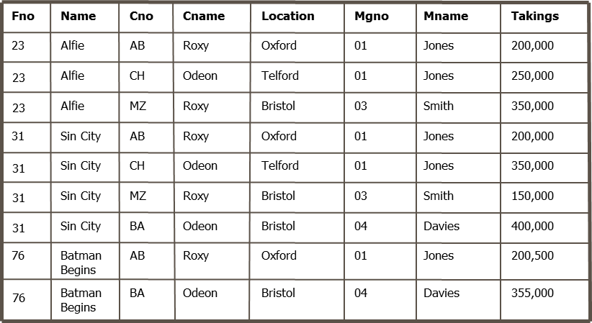
Transitive Dependencies (3NF)
A transitive dependency is a dependency of one non-prime attribute (an attribute that is not part of the primary key) to another non-prime attribute
Cno -> Mgno and Mgno → Mname
Mgno → Mname is a transitive dependency

Slide 49
The Normalisation Process

Slide 50
Normalization Process in DBMS
Database normalization is a stepwise formal process that allows us to decompose database tables in such a way that both data dependency and update anomalies are minimized. It makes use of functional dependency that exists in the table and primary key or candidate key in analysing the tables.
Normalization Process generally follows the Normal forms:
First Normal Form (INF) ->
Second Normal Form (2NF) ->
Third Normal Form (3NF)

Slide 51
The Normalisation Process
-> First Normal Form (1NF) Remove Repeating groups
A primary key must be identified
The table cannot contain repeating groups
  A repeating group is a set of logically related fields or values that occur multiple times in one record.
-> Second Normal Form (2NF) Remove Partial dependency
The table must be in 1NF.
Every non-key column must be dependent on all parts of the primary key → no partial dependencies!
-> Third Normal Form (3NF) Remove transitive dependency
The table must be in 2NF.
No non-key column may be functionally dependent on another non-key column → no transitive dependencies!

Slide 52
Example 1
Consider the following set of data in a table ORDERITEMS:
It contains a repeating group of ITEM NUM, ITEM DESCRIPTION, QUANTITY, and PRICE
First Normal Form (1NF) prohibits repeating groups.
ORDERID DATE CUSTID CUSTNAME STATE ITEMNUM ITEMDESCR QUANTITY PRICE
2301 6/23 101 Volleyrite IL 3786 net 3 35
4011 racket 6 65
9132 3-pack 8 4
2302 6/25 107 Herman’s WI 5794 6-pack 4 5
2303 6/26 110 WR Sports MI 4011 racket 2 65
3141 cover 2 10

Slide 53
Convert to 1NF
Remove repeat groups
Determine primary key (different possibilities):
ORDERID, ITEMNUM
ORDERID, ITEMNUM → DATE, CUSTID, CUSTNAME, STATE,ITEMDESCR, QUANTITY, PRICE
Resulting new table ORDERITEMS:
ORDERID DATE CUSTID CUSTNAME STATE ITEMNUM ITEMDESCR QUANTITY PRICE
2301 6/23 101 Volleyrite IL 3786 net 3 35
2301 6/23 101 Volleyrite IL 4011 racket 6 65
2301 6/23 101 Volleyrite IL 9132 3-pack 8 4
2302 6/25 107 Herman’s WI 5794 6-pack 4 5
2303 6/26 110 WR Sports MI 4011 racket 2 65
2303 6/26 110 WR Sports MI 3141 cover 2 10

Slide 54
Convert to 2NF
The goal is to eliminate partial dependencies
Identify all partial dependencies of the form P → A
with P as prime attribute(s) (part of the primary key) and A as dependent attribute(s)
For each partial dependency P → A:
  Create a new relation/table with attribute(s) P as primary key and attribute(s) A as value.
  Determine a decent name for the table.
  Remove attribute(s) A from the original table, make P foreign key(s) to the new table

Slide 55
Convert to 2NF
The original table ORDERITEMS is not in 2NF because
  ITEMNUM → ITEMDESCR, PRICE
  ORDERID → DATE, CUSTID, CUSTNAME, STATE
Create new tables:
ITEM
ORDER_ITEM
ITEMNUM ITEMDESCR PRICE
ORDERID ITEMNUM QUANTITY
3786 net 35
4011 racket 65
9132 3-pack 4
6-pack 5
3141 cover 10
2301 3786 3
2301 4011 6
2301 9132 8
2302 5794 4
2303 4011 2
2303 3141 2
ORDER
ORDERID DATE CUSTID CUSTNAME STATE
2301 6/23 101 Volleyrite IL
2302 6/25 107 Herman’s WI
2303 6/26 110 WR Sports MI

Slide 56
Convert to 3NF
The goal is to eliminate transitive dependencies (non-key dependencies)
Identify all transitive dependencies of the form
A → B with A as non-prime attribute(s) (not part of the primary key) and B as dependent attribute(s)
For each transitive dependency A → B:
  Create a new relation/table with attribute(s) A as primary key and attribute(s) B as value.
  Determine a decent name for the table.
  Remove attribute(s) B from the original table, make A foreign key(s) to the new table (in original table)

Slide 57
Convert to 3NF
ITEM and ORDER_ITEM are only in 3NF (why?)
We can find a transitive dependency in ORDER:
CUSTID → CUSTNAME, STATE
Create a new table CUSTOMER and modify table ORDER
ORDER
ORDERID DATE CUSTID (FK)
CUSTOMER
2301 6/23 101
2302 6/25 107
2303 6/26 110
CUSTID CUSTNAME STATE
Volleyrite IL
107 Herman’s WI
110 WR Sports MI

Slide 58
Normalisation: Discussion
We have seen how normalisation removed redundancies and anomalies
Normalisation is thus very useful or even crucial for operational data
However, it comes at a price:
  We split our data into several tables. To combine them again (e.g. for reporting), we need JOIN operations (cf SQL JOINs)
  JOIN operations are expensive when it comes to processing and memory resources, in particular, with large amounts of data
Normalisation often does not make sense in applications where redundancy and anomalies are a minor issue, for example
  Data Analytics / Data Warehousing
  ‘Big Data’, log file analysis

Slide 59
Summary
Normalisation: A important DBMS design technique supplement to Data modelling (ERM).
Normalisation removes redundancy and anomalies
3 Normal forms: 1NF, 2NF, 3NF, …
Normalisation is build based on Functional Dependencies
Process of Normalization UNF → 1NF → 2NF → 3NF

